Slide 1

Image processing using OpenCV

Slide 2
Overview
Introduction to Image processing
Basic Image processing operations
Shape detection
Object detection
Face detection

Slide 3
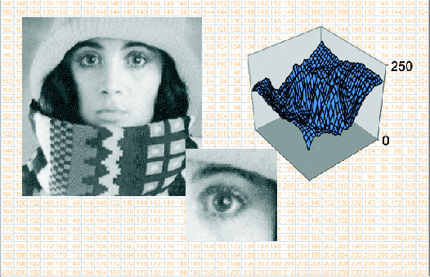
Image
An image is a mathematical representation of a physical observation as a function over a spatial domain

Slide 4
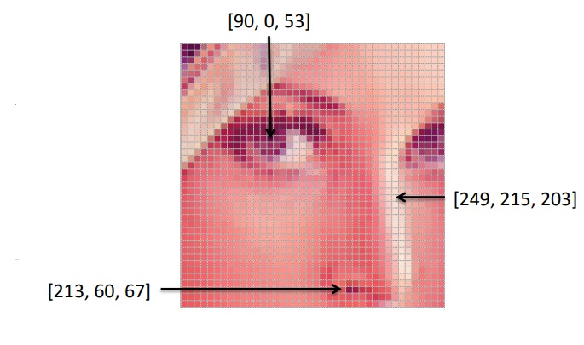
Digital Image
An image contains discrete number of pixels

Slide 5
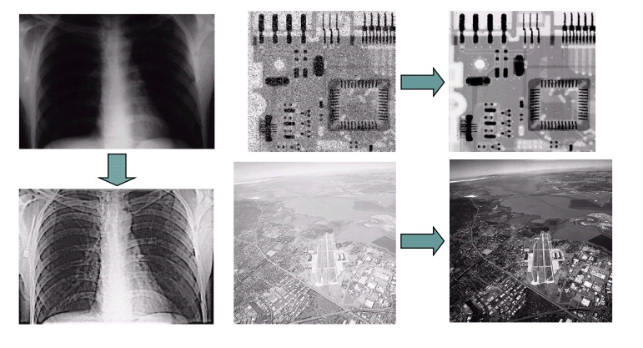
Image Processing
Algorithms that alter an input image to create new image

Slide 6
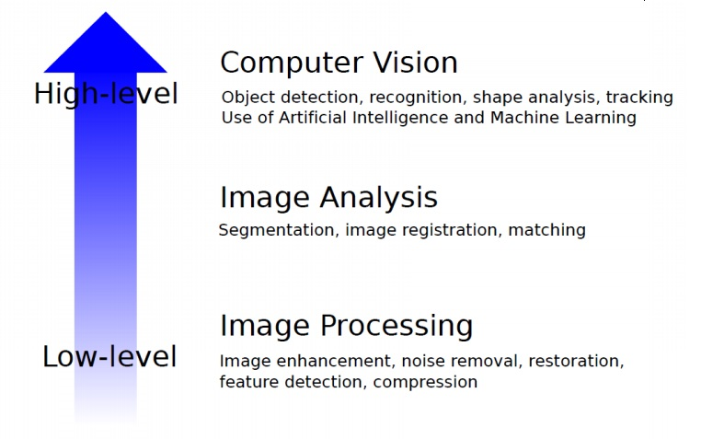
Computer Vision

Slide 7

OpenCV
open source computer vision and machine learning software library
more than 2500 optimized algorithms
C++, Python, Java and MATLAB interfaces

Slide 8
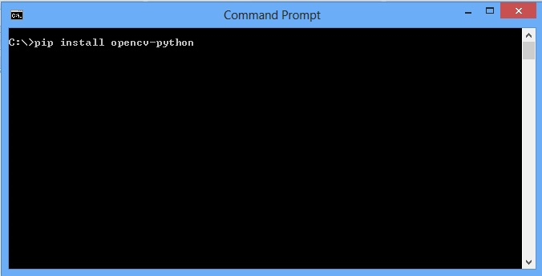
Installation
Install python from https://www.python.org/downloads/
Install opencv through Command prompt
pip install opencv-python
Other packages
pip install numpy
pip install imutils
pip install -U scikit-learn

Slide 9
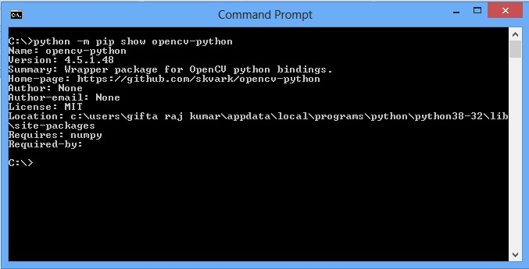
Check the Installation
python –m pip show opencv-python
python –m pip show numpy
python –m pip show imutils
python -m pip show scikit-learn

Slide 10
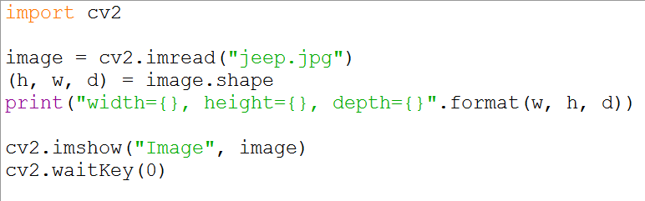
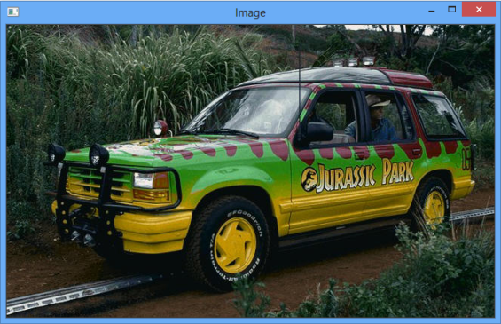
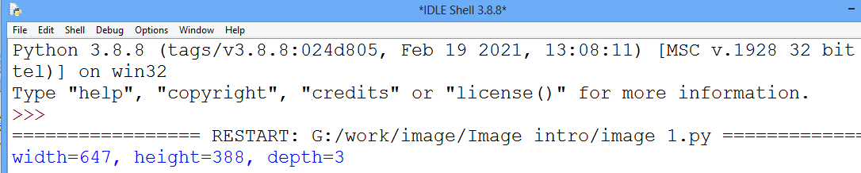
Loading and displaying an image

Slide 11
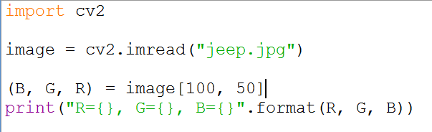
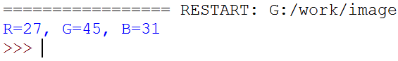
Accessing individual pixels

Slide 12
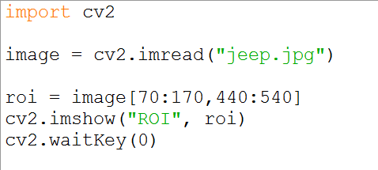
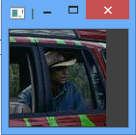
cropping

Slide 13
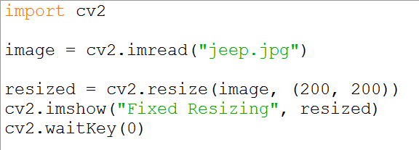
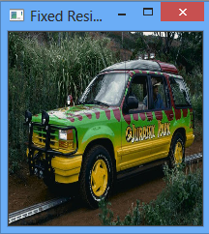
Resizing

Slide 14
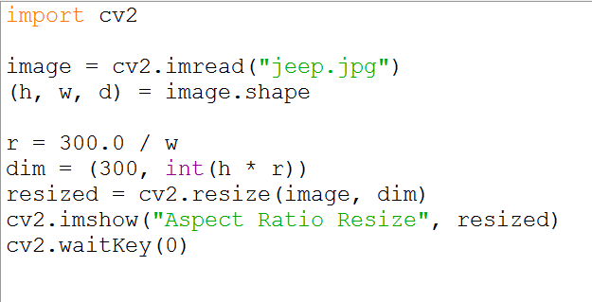
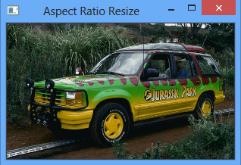
Resizing

Slide 15
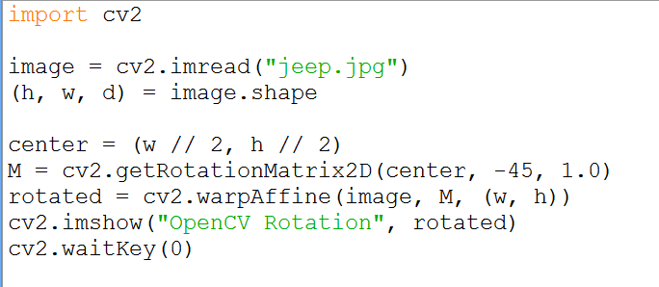
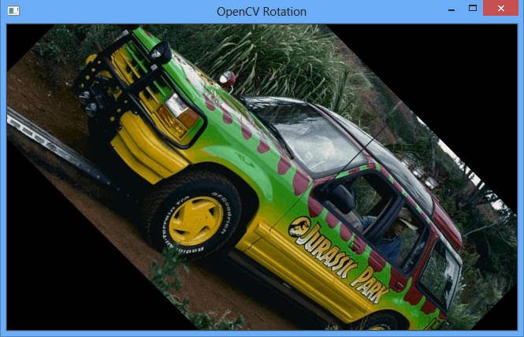
Rotate images

Slide 16
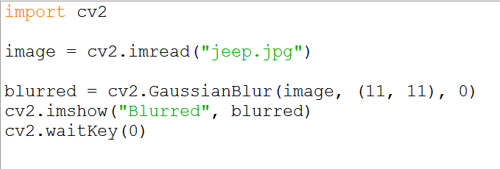

Smoothing an image

Slide 17
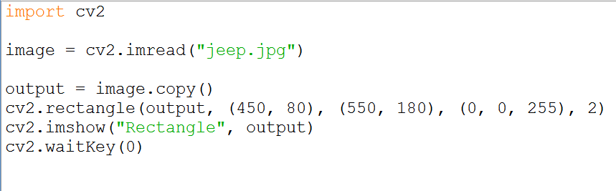

Rectangle

Slide 18
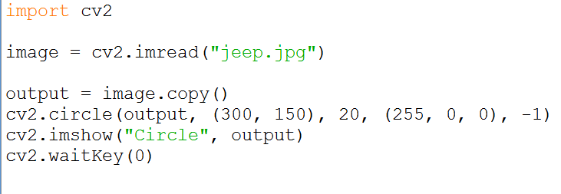
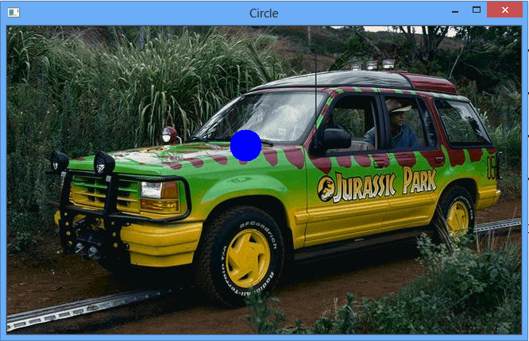
Circle

Slide 19
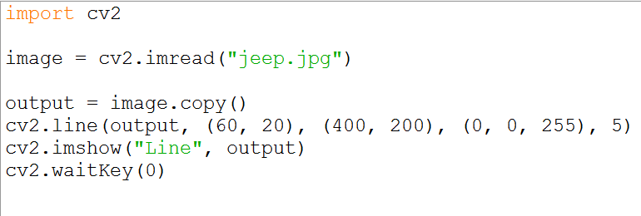
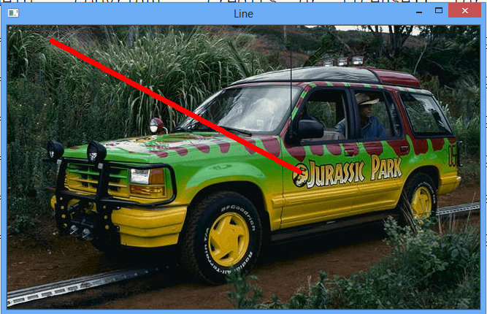
Line

Slide 20
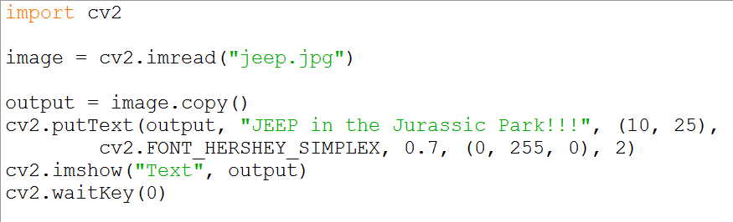
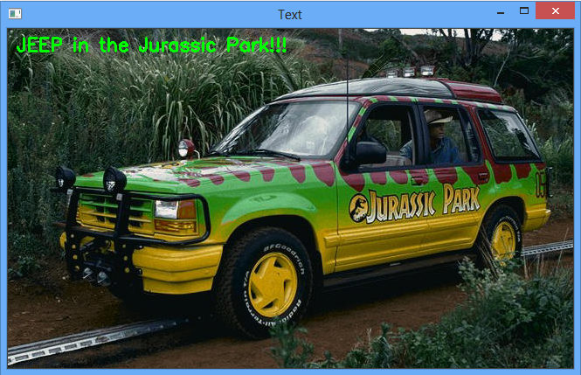
Writing Text

Slide 21

Contact
A.Arul Prabahar,
Deputy Manager,
NTSC, Ekkadu thangal,
Chennai -32.
Mob: 8754871885
E-mail: arulprabahar@gmail.com

